Slide 1

Manufacturing Analytics & Strategic Insights
Business Intelligence Report analyzing 2,937 records from November 2024 - January 2025
Total Revenue: $60,463,085 across 12 customers and 335 products

Slide 2

Executive Dashboard
$60M
2,937
100.1%
Total Revenue
Total Orders
Operational Efficiency
Strong market position
Active operations
Exceeds industry standards
0.0%
Average Profit Margin
Needs improvement

Slide 3
Critical Business Findings
Revenue Performance
Customer Risk
Operational Excellence
$60,463,085 demonstrates strong market position with average order value of $20,587
Top customer generates 80% of revenue - high concentration risk requiring diversification
100.1% efficiency exceeds targets with excellent cost control at -0.0% variance

Slide 4
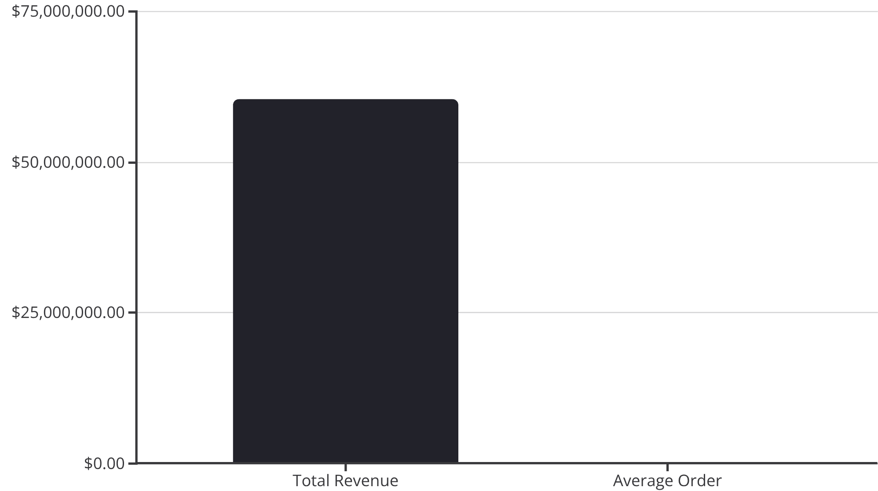
Revenue Analysis
Key Insights
Revenue growth rate of -5.3% indicates market challenges requiring strategic attention.
Average profit margin of 0.02% with improving trend needs enhancement through pricing strategy and cost optimization.

Slide 5



Customer Concentration Risk
69.6%
17.2%
13.2%
Company A
Company C
Others Combined
$42,053,649 revenue
$10,386,597 revenue
Remaining 10 customers
Top customer accounts for nearly 70% of revenue - immediate diversification needed

Slide 6
Operational Excellence Metrics
Manpower Efficiency: 100.2%
Material Efficiency: 100.0%
Machine Efficiency: 100.1%
Workforce productivity exceeds targets with optimal resource utilization
Perfect material utilization with minimal waste and optimal inventory management
Equipment performance above baseline with excellent maintenance practices

Slide 7
Risk Assessment Matrix
Risk Category
Level
Impact
Priority
Customer Concentration
High
High
High
Profit Margin Volatility
Low
Medium
Medium
Operational Efficiency
Low
Medium
Medium
Cost Control
Low
Medium
High

Slide 8
Strategic Recommendations
01
02
03
Customer Diversification Strategy
Comprehensive Pricing Review
Digital Analytics Investment
Conduct value engineering to improve profit margins and competitive positioning
Enhance decision-making and operational efficiency through automation and analytics
Reduce dependency on top customers and mitigate revenue risk through new customer acquisition

Slide 9
Implementation Roadmap
3 Months: Pricing Strategy Review
1
Target: >12% profit margin improvement
2
4 Months: Cost Management System
Target: <2% cost variance
6 Months: Customer Diversification
3
Target: 20% new customer revenue
4
9 Months: Operational Excellence
Target: 105% overall efficiency
12 Months: Digital Analytics Platform
5
Target: Real-time dashboards

Slide 10




Next Steps & Success Factors
Cross-Functional Teams
Leadership Commitment
Performance Monitoring
Establish project teams for each major initiative with clear accountability and regular progress reviews
Ensure visible support and clear communication of benefits to drive organization-wide buy-in
Implement continuous tracking systems with regular course correction based on feedback

